Slide 1
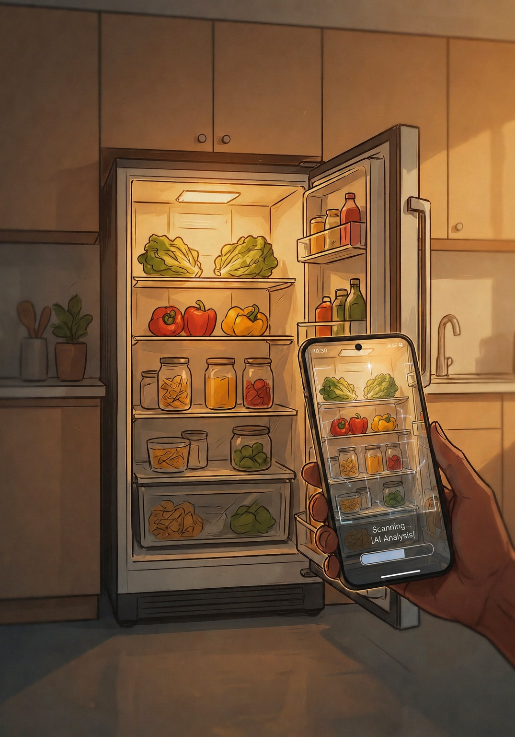
AI On-Device
Cooking from your fridge with Gemini Nano, MobileCLIP and Gemma
Salvatore Matrisciano · Stefano Soriano
Mobile Developers
DevFest Milano 2026
Notes:
SALVATORE:
Hi, hi everyone! I’m Salvatore Matrisciano and I’m a mobile developer…
STEFANO:
…and I’m Stefano Soriano, a mobile developer too. Hi everyone!
SALVATORE:
So, today we’re going to tell you a story. A true story.
The story of an app that looks inside your fridge and suggests what to cook tonight.
We built it with three different artificial intelligence models: Gemini Nano, Gemma and MobileCLIP.
And all 3 of them run right on the phone, locally.
We won’t just show you the final version, the one that works.
We’ll also show you the wrong turns we took, because that’s where we learned the most.
Let’s start with a question.

Slide 2
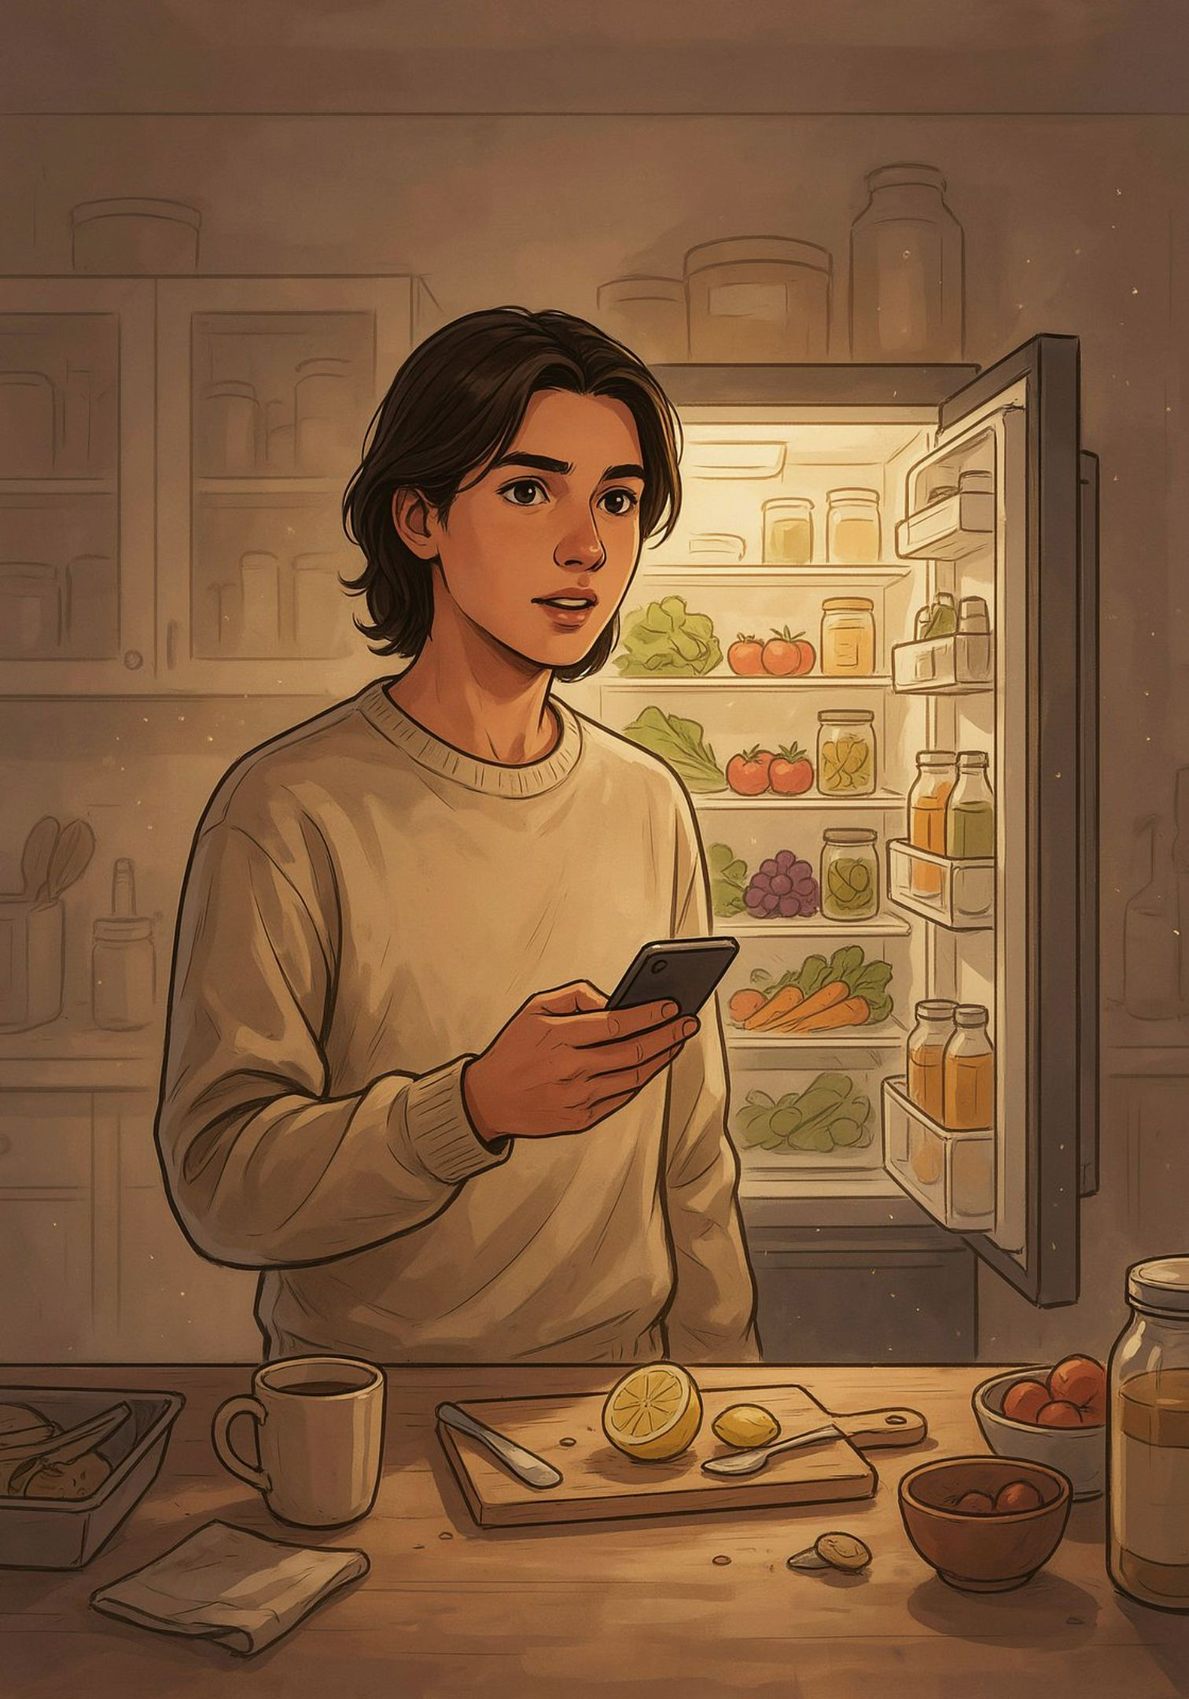
What happens when you decide to run all of your app’s AI right on the phone?
No cloud. No API keys. No photos of your users’ kitchens on a server.
Notes:
What happens when you decide to run all of your app’s AI right on the phone?
Today, when we add an AI feature to an app, it’s almost automatic:
grab an API key, call a model in the cloud, send the request, wait for the answer.
It works, it’s convenient, we all do it.
Main point: calling an AI API from an app comes, first of all, with a cost.
Then, in our case, the request is a photo of the inside of someone’s kitchen.
Of their fridge. Of what they eat, of how they live.
So we asked ourselves: what if we didn’t send it anywhere?
No cloud. No API key to protect. No photo on any server.
Every request you send to a server is one more thing to protect, to justify, to explain to the user in the privacy policy, and also, above all, to pay for.
Before we go any further, let us show you the app.

Slide 3
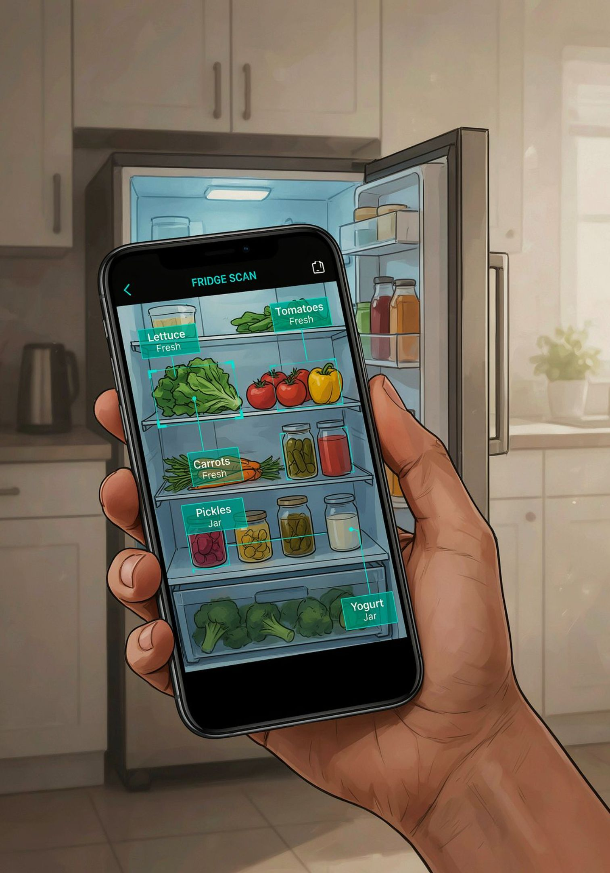
THE APP
AI Pantry: scan your fridge, get dinner
Snap your fridge → it recognizes the ingredients
It remembers your pantry
It suggests what to cook and writes the recipe
100% on-device: photos and prompts stay on the phone
Notes:
The app is called AI Pantry, and the idea is very simple: take a photo of your fridge and get a recipe idea for dinner.
Here’s how it works. First you take one or more photos of your fridge, and the app recognizes the ingredients it sees.
Then, from those photos, it builds the inventory of your pantry. So the app remembers what you have.
And then, from what you actually have in your pantry, it generates recipe ideas.
Finally, if you like one, it generates the full recipe, with all the steps to cook it.
And the key point is that it’s all 100% on-device.
So the photos and the prompts never leave the phone.
Let’s take a look:
────────────────────────
🎬 LIVE DEMO:
[Before the talk: phone mirrored, phone language set to English, airplane mode ON, empty pantry (“Your pantry is empty”, use “Clear all” if needed), Gemma already ready (no “Preparing Gemma 4 E2B…” banner). Keep a tested fridge photo and pantry photo in the gallery, to pick with the gallery button at the bottom left. Backup video ready: demo.mp4.]
[Timings, from the video: each photo is analyzed in 20-25 seconds, the 4 recipes arrive in under a minute, the full recipe in just over 2 minutes.]
[point to the status bar]
First thing: look up here. The phone is in airplane mode. No internet needed.
[tap “Scan my fridge”, “Fridge” already selected, take the photo or pick it from the gallery]
I pick “Fridge”, frame the fridge and take the shot.
[on screen “Recognizing ingredients”: the areas being analyzed light up on the photo (“Areas scanned”) and the ingredients appear one by one]
What’s happening now is the perception part: the app is figuring out which ingredients are in the photo, area by area, and you see them appear as soon as it finds them. During the talk we’ll explain why this part, at first, took minutes, and how we brought it down to a few seconds.
[the “N ingredients found” sheet opens]
Here they are. [read out 3-4 ingredients that actually appear]. Each one has its own confidence, and the ones below a certain threshold are already discarded. If something is wrong, I remove it with the X. [remove an item if needed]
[point to the line at the top “MobileCLIP-S2 zero-shot · LiteRT · on device”]
And look at this line: the app tells you which engine did the work. On this phone it’s [read: MobileCLIP-S2 or Gemini Nano]. Keep that in mind, because it’s the heart of the talk.
[tap “Scan another”, select “Pantry”, take or pick the pantry photo]
I do the same with the pantry. The two scans add up. [the sheet now counts the ingredients of both]
[tap “Add to fridge and pantry (N)”, back to “Your kitchen” with fridge and pantry]
I add everything. And this is the inventory, saved locally on the phone.
[tap “What can I cook? (N)”]
Now the fun part. I ask the app: what can I cook with this stuff?
[“Creating your recipes” screen, then the recipes arrive one at a time (“Recipe 2 of 4”…)]
This is where a different model comes in, a real LLM, Gemma, because inventing a recipe is a completely different job from recognizing a watermelon. We’ll look at this in detail too.
[the “Here’s what you can cook” list appears]
Here are four dinner ideas, with time and difficulty. They’re sorted by how much they use what I actually have: the ones that need me to buy something end up at the bottom, and the app tells me what I’m missing. [if a recipe shows “Missing: …”, point to it] And if they don’t convince me, “More recipes” suggests four more.
[open a recipe: at the bottom “Writing the steps…”]
I open this one. Amounts and steps didn’t exist until I opened it: it’s writing them right now, here on the phone. [the amounts appear, then the “Instructions” steps one at a time, then the “Variants”. Don’t wait for the end: the full recipe takes just over 2 minutes]
And remember: airplane mode. No network calls. No per-call cost. No photo of this fridge ended up on a server.
This is AI Pantry. Now let us tell you how we got here, and why it took more attempts than we expected. [back to the slides]
[PLAN B: if the demo freezes → “The on-device demo decided to be very on-device” → start the backup video (demo.mp4) and narrate it with the same script. In the video the phone is not in airplane mode: skip the airplane mode lines. The full recipe takes the last 2 minutes of the video: you can skip ahead.]

Slide 4

MOTIVATION
Why on-device?
Privacy, first of all
No server sees the photos
Kitchen photos never leave the phone.
No Data Processing Agreement (DPA)
No vendor receives the photos: nothing to sign.
No data retention problem
If you never store the data, retention is a non-issue.
No logs to leak
The safest data is the data you never collected.
Notes:
Ok, so let’s take a step back.
Why on-device? Why make life harder, when a cloud API would have done the job much faster?
The first answer is privacy. First of all.
No server sees the photos.
Kitchen photos never leave the phone.
And a photo of a fridge says much more than you’d think: eating habits, allergies, maybe health conditions, and sometimes even a piece of the home in the background.
No Data Processing Agreement.
When you build an app, as soon as you send user data to a third-party vendor, the whole round of legal, DPAs, assessments starts…
If no user data leaves the phone, there’s no agreement to sign.
No data retention problem.
How long do I keep the photos? Where? Who can delete them?
If you never store them, the question doesn’t even come up.
And finally, no logs on the server.
No cloud requests means there’s nothing to leak, and nothing to breach.
The safest data is the data you never collected.
But privacy isn’t the only reason.

Slide 5
MOTIVATION
…then resilience and cost
Works without internet
No round trip to the server
No network, airplane mode, weak signal (even in basement kitchens)
No network latency: the “backend” is already in your pocket.
Cloud cost grows with usage
On-device flips the cost
You pay for every photo, for every user, every day.
Inference runs on the user’s phone: the cloud bill drops to zero.
Notes:
Then there’s resilience and cost.
Resilience means, first of all, that it works even without internet.
No network, in airplane mode, as we just saw, or with a weak signal.
And a fridge is in a kitchen, maybe in an old house, maybe in a cellar or a basement, or anyway somewhere internet doesn’t reach.
Then, no round trip to the server. No network latency, no cold start.
The “backend”, in quotes, is already warm: you’re holding it.
Then there’s cost, which for a real product is huge: cloud cost grows with usage.
Every multimodal call is paid per image and per token.
And you multiply that by every scan, every active user, every day.
The more successful the app, the more it costs.
On-device completely flips this model.
Inference runs on the user’s hardware, and the cloud bill stays at zero.
Even with a million users.
So: privacy, resilience and cost.
Now, which model do we use?

Slide 6
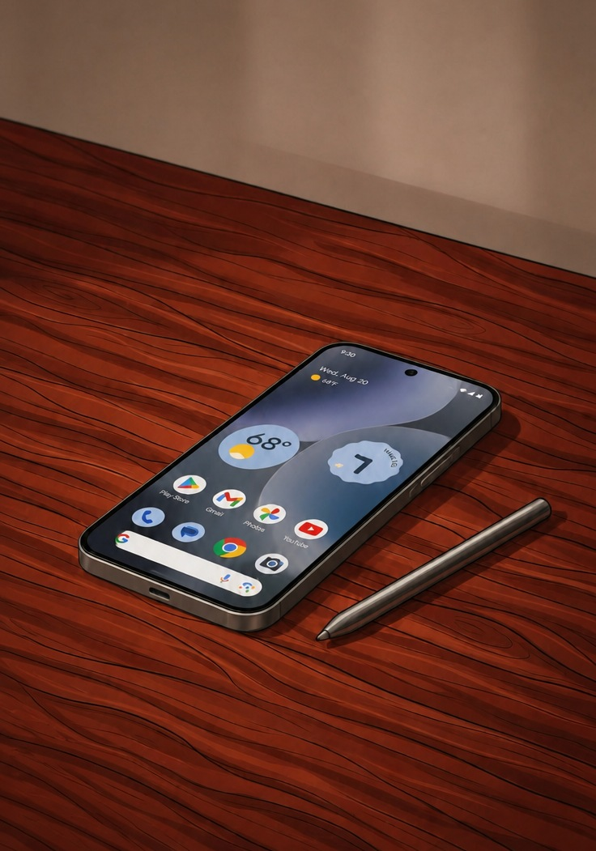
FIRST CHOICE
The obvious choice: Gemini Nano
Already in the OS, multimodal
One dependency, zero megabytes in the APK
Hardware acceleration and updates handled by Google
Perfect. Except…
Notes:
Today, the obvious choice, if you develop for Android, is Gemini Nano.
It’s the on-device model Google built into Android: it’s not in your app, it lives in the operating system.
And it’s multimodal: you can give it a photo and some text, and it answers with text.
Exactly what you need to scan a fridge: “here’s the photo, tell me what’s inside”.
Then the best part is that it’s a Gradle dependency.
So zero megabytes in the app.
There’s no model to bundle, download or update: the platform takes care of all of it.
Plus, hardware acceleration included: it uses the phone’s hardware accelerators, without writing a single line of chip-specific code.
And updates are handled directly by Google: when a better version of the model comes out, it reaches users without a new app release.
For an Android developer, it’s almost too good to be true.
On paper it was perfect. [pause]
Except…

Slide 7
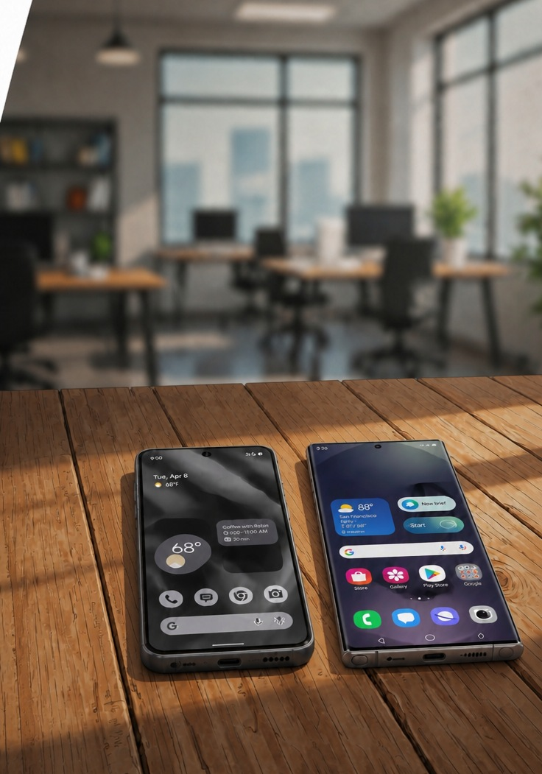
FIRST CHOICE · THE PROBLEM
It only runs on the latest flagships.
Pixel 10/11, Galaxy S26 and a few other flagships:
not the phones most people actually have.
Notes:
…it only runs on the latest flagships.
Pixel 10, Pixel 11, Galaxy S26…
Beautiful phones.
But they’re not the phones most people actually have in their pockets.
And for anyone shipping an app, that’s a serious problem.
If you build your app’s main feature on a model that exists only on a small slice of devices, for everyone else the app simply doesn’t work.
And there’s nothing you can do in code: it’s not a matter of permissions or Android version, it depends on the hardware and on what Google decided to support.
So we understood right away: Gemini Nano could be a bonus, but it couldn’t be the foundation of our app.
We needed a plan B that would run on every phone, or almost.

Slide 8

PLAN B
A single multimodal LLM to do everything
Gemma 4 E2B
Google’s open model: you ship it yourself, and it runs even where Nano isn’t available (with enough RAM).
It worked.
Correct ingredients, valid JSON, real recipes.
But it took 5-10 minutes per scan
On a Pixel 7, a four-year-old phone.
Nobody waits 10 minutes for a dinner idea.
Notes:
Plan B was simple, at least in our heads: a single multimodal LLM that does everything.
We chose Gemma. Version 4 E2B. So Gemma, fourth generation, 2 billion effective parameters.
Open weights, multimodal, meaning vision plus text, and it runs on any phone, because you ship the model yourself.
The idea looked elegant: one model, two jobs.
First you ask it “what’s in this photo?”, and then you ask it “what can I cook with it?”.
So we integrated it, and it worked.
Correct ingredients, valid JSON, real recipes.
The model recognized the eggs, told yogurt apart from milk, respected the format we asked for.
Quality-wise, it looked perfect.
[pause]
But it took 5-10 minutes for a single scan.
On a Pixel 7, a mid-range phone.
And obviously nobody points their phone at the fridge and waits ten minutes for a dinner idea.
In ten minutes you can order a pizza and have it delivered. [pause]
So we had two roads (Gemini Nano and Gemma) and neither one worked: one fast but only for a few, and one for everyone but unusable.
How did we get out of it? We’ll tell you in five chapters.

Slide 9
THIS SESSION
How we solved it, in five chapters
01
02
03
Gemini Nano via ML Kit GenAI
One model to rule them all: Gemma
Zero-shot detection with MobileCLIP-S2
A free upgrade, never the foundation
…and why it was so slow
A model that compares, not one that writes
04
05
Where the LLM earns its place
Distribution
Recipe generation
Every model travels differently
Notes:
Chapter 1: Gemini Nano, through Machine Learning Kit GenAI.
How to use it as a free upgrade, but never as the foundation of our app.
Chapter 2: one model to rule them all (Gemma), and why it was so slow.
Chapter 3: zero-shot detection with MobileCLIP-S2.
The chapter where we went from minutes to seconds.
Chapter 4: where the LLM really earns its place, that is, recipe generation.
And finally, chapter 5: distribution.
Because every model reaches the phone in a different way, and that matters much more than you’d think.
Spoiler alert, so there’s no suspense: in the end we used all 3 models.
But each one for a different job, and the main point is understanding why.

Slide 10

CHAPTER 1 · GEMINI NANO
Starring: Gemini Nano
The smallest member of Google’s Gemini family
Distilled to run on a phone. Same DNA as its cloud siblings, shrunk until it fits a phone’s memory and thermal budget
Multimodal: photo + text in, text out
Exactly our problem: "look at this fridge, tell me what's inside"
A single shared model per device
Updated by Google Play services: nano-v3 / nano-v4 depending on the device, it improves without you shipping anything
The cost to your app: zero megabytes
Notes:
Chapter one. Starring: Gemini Nano.
Gemini Nano is the smallest member of Google’s Gemini family.
It’s a model distilled to run on a phone: same DNA as its siblings running in the cloud, but shrunk until it fits a smartphone’s memory budget and thermal budget.
Because on a phone it’s not only about how fast it is, but also about how hot it gets.
It’s multimodal: photo plus text in, text out.
And that was exactly the problem we wanted to solve with our app: “Look at this fridge, tell me what’s inside”.
Then there’s an important architectural detail: there’s a single shared model per device. Not one per app.
It’s updated through Google Play services, and depending on the device it can be nano v3 or v4.
So the model improves over time without shipping new app updates.
You can use it through Machine Learning Kit GenAI, which exposes both ready-made APIs, like summarization or text rewriting, and a Prompt API where we can write the prompt ourselves.
And of course we used the Prompt API.
And the cost to your app? Zero megabytes.
But how can it cost zero? Where is the model?

Slide 11
CHAPTER 1 · GEMINI NANO
The model lives in AICore, not in your app
AICore is an Android system service
Multimodal prompts:
photo + text in, text out
The integration is one dependency and one rule…
It manages weights, storage, updates and hardware acceleration: your app never touches a model file.
It runs on weights you never have to ship, download or update.
Notes:
The model lives in AICore, not in the app.
AICore is an Android system service.
It manages the model weights, storage, updates and hardware acceleration.
The app never touches a single model file.
You just send a request, and AICore returns an answer.
And requests can be multimodal: photo plus text in, text out.
All of this runs on weights you never need to ship, download or update.
And there’s an advantage not to underestimate: if 10 apps on the same phone use Gemini Nano, there’s only one model on disk.
Not ten copies of a few gigabytes each.
For the user it saves a huge amount of space, and for app developers it’s one less problem.
For us developers it’s a very convenient mental model: it’s like using the camera or GPS.
It’s a system capability, not something to package into the app.
But precisely because it’s a system capability, it may or may not be there.
And so the integration comes down to one dependency and one rule.

Slide 12
CHAPTER 1 · GEMINI NANO
One dependency, one rule: check, then call
implementation("com.google.mlkit:genai-prompt:1.0.0-beta2")
val model = Generation.getClient()
suspend fun detect(bitmap: Bitmap) =
when (model.checkStatus()) { // runtime, not compile time
FeatureStatus.AVAILABLE -> detectWithNano(bitmap)
FeatureStatus.DOWNLOADABLE -> {
scope.launch { model.download().collect() } // download in background
clip.detect(bitmap) // fallback
}
else -> clip.detect(bitmap) // fallback: MobileCLIP, not an error
}
suspend fun detectWithNano(bitmap: Bitmap) = model.generateContent(
generateContentRequest(ImagePart(bitmap), TextPart(prompt)) { temperature = 0.2f })
Checked on every call: availability changes at runtime.
Notes:
The dependency is the Machine Learning Kit GenAI Prompt API.
Then you get the client with getClient().
And now the rule: before calling the model, you always have to call checkStatus().
Availability is a runtime question, not a compile-time one.
You can’t know it just by building the app.
There are three states we care about.
AVAILABLE: the model is there, it’s ready, we can use Nano.
DOWNLOADABLE: the device supports it, but the model hasn’t been downloaded yet. In that case we opportunistically start the download in the background, but meanwhile, for this request, we use the fallback. We don’t make the user wait.
And in every other case, meaning an unsupported device, straight to the fallback.
Then the actual call is trivial: generateContent with an ImagePart, the bitmap of the photo, and a TextPart with the prompt.
Low temperature here, 0.2, because we don’t want creativity: we want a reliable list of ingredients.
And the fallback isn’t an error message: it’s another detection engine.
The most important thing is that the same phone can answer differently over time.
Today the model isn’t downloaded yet, tomorrow it is, the day after the system may remove it to free up space.
So that check isn’t done once at startup: it’s done every time.
Good. Nano solves the problem on flagships.
But not for everyone else. So let’s go back to our plan B.

Slide 13

CHAPTER 2 · ONE MODEL TO RULE THEM ALL
Starring: Gemma 4 E2B
Google’s open-weights family
Gemini’s downloadable sibling. The weights are yours to bundle and ship in your app; no per-call billing, no server
'4 E2B' = 4th generation, 2 billion effective parameters
Designed for phones. Memory tricks give big-model quality with a phone-sized RAM footprint; instruction-tuned
Multimodal: a vision encoder feeds the language model
It can look AND write. Exactly what a fridge scanner needs, and it can also generate the recipes
Via LiteRT-LM on every Android
One model, one integration, both jobs: detection AND recipes
Notes:
STEFANO:
Chapter two. Starring: Gemma 4 E2B.
Gemma is Google’s open-weights family.
You can think of it as Gemini’s downloadable sibling.
The weights are yours: you bundle them and ship them with your app.
No per-call billing, no server.
What does “4 E2B” mean? Fourth generation, and 2 billion effective parameters.
That “E” stands for effective: it’s designed specifically for phones, with memory tricks that give it the quality of a bigger model, but with a phone-sized RAM footprint.
And it’s instruction-tuned, so it follows instructions well.
It’s multimodal: there’s a vision encoder feeding the language model.
So it can look and it can write.
Exactly what a fridge scanner needs, and on top of that it can also generate the recipes.
And it runs through LiteRT-LM on any Android.
It doesn’t depend on which chip the user has.
One model, one integration, two jobs: detection and recipes.
For those who don’t know it, LiteRT is the new name of TensorFlow Lite, and LiteRT-LM is its extension built specifically to run language models on device: it handles tokenization, caching, conversation sessions, and picks CPU or GPU.
It looked like the perfect architecture.
Let’s see how we used it.

Slide 14
CHAPTER 2 · ONE MODEL TO RULE THEM ALL
Ask the LLM to look, and to write
val prompt = """
This is a photo of the inside of a $place.
Identify the food ingredients you can see, at most 15.
Respond with ONLY a JSON array (no markdown, no extra text):
[{"name": "...", "quantity": "..."}]
Only include items you actually see. Use common English ingredient names.
""".trimIndent()
conversation.sendMessage(Contents.of(Content.Text(prompt), Content.ImageBytes(jpeg)))
// → JSON parsing, silent retries if malformed
Detection as a prompting problem: no dataset, no training. Just ask.
What could possibly go wrong?
Notes:
The approach was: ask the LLM to look, and then to write.
This is, more or less, the prompt we used.
“This is a photo of the inside of a fridge. Identify the food ingredients you can see, at most 15.
Respond with only a JSON array, no markdown, no extra text.”
And we give it the schema: name and approximate quantity. And finally: “only include the items you actually see”, to limit hallucinations.
Then we send the photo and the prompt into the conversation, take the text, parse the JSON, and if it’s malformed we silently retry. We’ll come back to this.
Note the fifteen-item limit too: it’s not random.
Every extra ingredient in the answer means more tokens to generate, and, as we’ll see in a moment, output tokens are expensive.
And the fascinating part is the note at the bottom: detection becomes a prompting problem.
No dataset to collect, no training, no labeling. Just ask.
[pause]
What could possibly go wrong?
[pause]
Well, you already know: 5-10 minutes per scan. The interesting question is: why?

Slide 15
CHAPTER 2 · WHY IT WAS SO SLOW
The two-phase cost of multimodal LLMs
Phase 1: prefill
Phase 2: decode
The photo becomes hundreds of image tokens, all processed before any output appears.
The answer is generated one token at a time through a 2-billion-parameter model.
5-10 minute scans on a mid-range phone
Know this cost model
Arithmetic, not model quality, decides between seconds and minutes.
Before promising any multimodal UX.
Notes:
Why was it so slow?
Here’s the most important concept of this chapter: the two-phase cost of multimodal LLMs.
Phase one: prefill.
Before writing even a single word, the model has to read the whole input.
And our photo isn’t “an image”: for the model it becomes a few hundred image tokens.
Tokens that all have to be processed before any output appears.
On a mid-range phone, that alone is already heavy.
Phase two: decode. The answer is generated one token at a time.
And every single token goes through a two-billion-parameter model.
A JSON with fifteen ingredients and quantities is a lot of tokens, and each one costs a full pass through the model.
To give you an idea: in the cloud, on data center GPUs, both phases are so fast you don’t even think about them.
On the phone, with shared memory, thermal limits and a battery you don’t want to drain, you feel every token.
Put the two phases together, and on a mid-range phone you get a 5-10 minute scan.
And note: it’s not a model quality problem. The answers were right. It’s the arithmetic that decides between seconds and minutes.
So, the advice: know this cost model before promising any multimodal UX.
Before telling your product owner “let’s have them snap a photo and the AI figures everything out”, do this math.
And at that point we asked ourselves the right question:
Do we really need a model that writes, to recognize an orange?

Slide 16

CHAPTER 3 · ZERO-SHOT DETECTION
Starring: MobileCLIP-S2
Not an LLM: it generates nothing, it measures
How well an image matches a sentence. A model of the CLIP family: Contrastive Language–Image Pre-training
Apple’s mobile version of CLIP
Distilled from bigger models. S2 is the sweet spot: zero-shot as accurate as bigger models, at phone latency
~140 MB, 256×256 input, 512-dimensional embeddings
Tiny next to a 2-billion-parameter LLM, and with a completely different cost profile
Open weights, exports cleanly to LiteRT
Runs on any Android phone. No AICore needed, no silicon lottery: this can be the foundation
Notes:
Chapter three. Starring: MobileCLIP-S2.
First thing to understand: it’s not an LLM.
It doesn’t generate anything. It measures.
It measures how well an image matches a sentence.
It’s a model of the CLIP family, which stands for Contrastive Language–Image Pre-training.
MobileCLIP is the mobile version of CLIP, made by Apple.
Yes, in an Android talk at a DevFest we’re using an Apple model: that’s one more reason open source is great.
It’s distilled from bigger models, and the S2 variant is the right trade-off between accuracy and speed: in zero-shot it’s as accurate as bigger models, but with phone latency.
The numbers: about 140 megabytes, 256 by 256 pixel input, 512-dimensional embeddings.
Tiny, next to a 2-billion-parameter LLM, and above all with a completely different cost profile.
And “zero-shot” is the key word: it means the model recognizes categories it was never explicitly trained on.
We didn’t do any fine-tuning on ingredients.
We didn’t collect a single fridge photo.
Open weights, it exports cleanly to LiteRT, and it runs on any Android phone.
Now this can be the foundation of our app.

Slide 17
CHAPTER 3 · ZERO-SHOT DETECTION
Recognition doesn’t need a model that writes, but one that compares
CLIP-family models: two small encoders
"Is it an orange?" → cosine similarity
A ~140 MB encoder is all it takes
Trained on millions of image–caption pairs, so matching pairs end up close together in vector space.
Recognition becomes geometry: a dot product, not a generated paragraph.
MobileCLIP-S2 runs on LiteRT on any Android phone, no decode loop required.
Notes:
The key insight is this: recognition doesn’t need a model that writes, but a model that compares.
How does CLIP work?
It’s two small encoders: one for images, one for text.
They were trained on millions of image–caption pairs, so that a photo and the sentence describing it end up close together in the same vector space.
The photo of an orange and the sentence “a photo of an orange” become two vectors pointing more or less in the same direction.
And so the question “is it an orange?” becomes a cosine similarity.
I take the image vector, I take the sentence vector, I compute a dot product.
Recognition becomes geometry.
A dot product, not a generated paragraph.
And the nice thing about cosine similarity is that it’s a number: from minus one to one.
We can set a threshold, sort the results, discard the unconvincing ones.
No JSON to parse, no hallucinations in the form of text: at worst a low score.
Now think back to the two phases from before.
Here there’s no decode: I don’t generate any tokens.
There’s no prefill of hundreds of tokens through two billion parameters.
There’s just a roughly 140-megabyte encoder looking at the photo. That’s it.
MobileCLIP-S2 runs on LiteRT, on any Android phone, with no decode loop at all.
But there’s an obvious question: if the model compares an image with sentences… which sentences? Where do they come from?

Slide 18
CHAPTER 3 · THE TRICK
We built the vocabulary ourselves, and it’s a text file
# scripts/ingredient_labels.txt · 870 hand-curated ingredient labels
oranges
strawberries
bananas
…
lactose-free milk|milk
bottle of whole milk|milk
…
~an empty shelf
# prepare_clip_assets.py · offline, on the laptop, just once
TEMPLATES = ["a photo of {}", "a photo of {} in a refrigerator",
"a photo of {} on a pantry shelf", "a close-up photo of {}"]
← specific match | name shown to the user
← distractor: absorbs the empty crops
The “classifier” is a text file: want one more ingredient? Add a line.
Notes:
And here’s the trick: we built the vocabulary ourselves.
And it’s a text file.
It’s called ingredient_labels.txt, and it contains more than eight hundred hand-curated ingredient labels.
Oranges. Strawberries. Bananas.
And look at this line: “lactose-free milk, pipe, milk”. On the left there’s the specific label, the one we use for matching; on the right the simple one, which we show to the user. So the model recognizes the carton of whole milk, but in the pantry you just see “milk”.
This trick solves a very concrete problem: CLIP works better with specific descriptions, but for recipes a clean pantry is better, not “carton of semi-skimmed whole milk”.
Then: we compute the text embeddings offline, on a laptop, just once.
For each label we use four templates, like “a photo of an orange”, and average the vectors, which makes the result more robust.
The result is about 4.5 megabytes of vectors, bundled in the APK.
And here’s the key point: since the labels don’t change at runtime, there’s no point running the text encoder on the phone. We leave it on the laptop.
So on the phone only the image encoder runs.
The flow is: we cut the photo into many crops, at two different scales, compute the embedding of each crop, compare it with cosine against all the labels, and the best matches above a confidence threshold win.
And a clever detail: the file also contains a few “distractor” labels, which aren’t food.
They absorb the empty crops, the shelf, the rack, so they don’t turn into an ingredient.
And the nice thing is this: the “classifier” is an editable text file.
Want to add an ingredient? Add a line, regenerate the vectors, done. No dataset, no training.
And the result?

Slide 19

CHAPTER 3 · THE RESULT
Same phone. Same fridge photo.
Minutes → seconds.
Notes:
Same phone. Same fridge photo.
[pause]
Minutes… become seconds.
[pause]
We didn’t change phones. We didn’t buy a new chip.
We didn’t quantize the LLM to the bone.
We changed the class of model.
We stopped asking a generative model to do a comparison job.
And the nice part is that we didn’t throw the old approach away: the LLM’s detection quality was great, but MobileCLIP gives us comparable quality in a fraction of the time, on any phone.
And it’s the most important lesson of the whole talk: before optimizing the model, ask yourself whether it’s the right model for the job.
But at this point we had 2.6 gigabytes of Gemma on the phone, and no work for it to do.

Slide 20
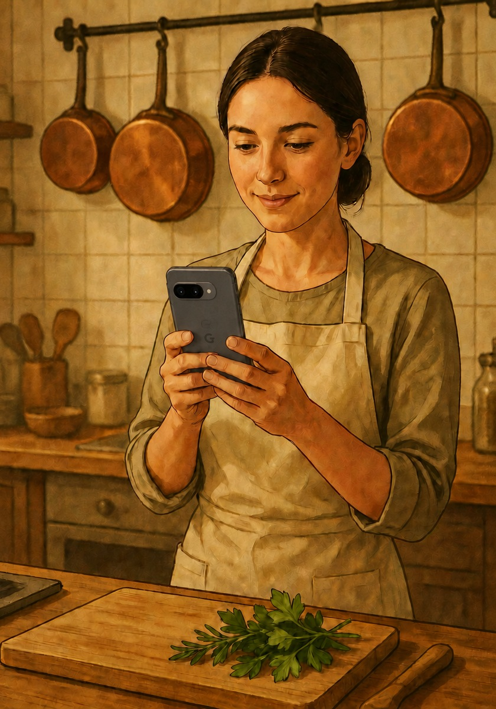
CHAPTER 4 · WHERE THE LLM EARNS ITS PLACE
Starring:
Gemma Returns
The same 2.6 GB, already on the phone
Now it does the job it was built for. We benched it for perception; we never uninstalled it
Text only, this time
No photo, no image tokens, no huge prefill.
Input: a short list of ingredients
Instruction-tuned generation: recipes are new text
Invented on the spot. The one job in the app that no comparison, no vocabulary, no lookup could ever do
Runs via LiteRT-LM on the GPU
Notes:
Chapter four. Starring: Gemma Returns.
It’s the same 2.6 gigabytes we already had on the phone.
But now it does the job it was built for.
We had benched it for perception, but we never uninstalled it.
The difference is that this time it works with text only.
No photo, no image tokens, no huge prefill.
The input is a short list of ingredients: “eggs, zucchini, tomatoes, Parmigiano”.
So the two-phase cost, which had killed us before, now plays in our favor: a tiny prefill, and a decode that produces exactly what we want.
And here instruction-tuned generation makes sense, because recipes are new text.
They’re invented on the spot.
It’s the one job in the app that no comparison, no vocabulary, no lookup could ever do.
And it really does need an LLM.
And there’s another advantage: recipes need creativity.
Here we can raise the temperature a bit, let the model suggest pairings we didn’t expect.
In detection, creativity was a flaw; here it becomes the product.
It runs through LiteRT-LM, with the GPU as the first choice.
And since GPUs on Android phones are a very varied world, if the GPU hangs or errors out, the app notices, switches to the CPU and remembers it for next time.
And LiteRT-LM also supports streaming the answer, token by token.
For UX, that changes everything.

Slide 21
CHAPTER 4 · WHERE THE LLM EARNS ITS PLACE
Recipes are creation, not recognition
From an inventory to dinner ideas
Two-stage prompting
That’s why generative models exist: no closed vocabulary can do it.
A cheap list first, then the full recipe on demand: shorter prompts, less waiting.
Defensive JSON parsing with silent
retries
Text-only generation runs at 15–25 tok/s
Small models break format contracts: expect it, don’t apologize.
No photo, no image prefill: you only wait for the text.
Notes:
Recipes are creation, not recognition.
Going from an inventory to dinner ideas is exactly why generative models exist.
No closed vocabulary can do it.
Three tricks that saved us.
First: two-stage prompting.
First we ask for a list of five recipes, with title, time, difficulty and ingredients used, but no steps.
Then, only when the user opens one, we generate the steps and variants.
Shorter prompts, shorter outputs, less waiting.
Second: defensive JSON parsing with silent retries.
Small models easily break format contracts: an extra comma, a markdown block around the JSON, a polite sentence before the answer.
It’s not a rare bug: it’s normal behavior.
So expect it, don’t apologize to the user.
In practice: we strip the markdown blocks, extract every JSON object we find, accept field names written in different ways, and if a single recipe is broken we drop that one, not the whole list.
And if there’s really nothing valid, we retry, up to four times, before showing the user an error.
Third: without a photo, text-only generation runs at 15–25 tokens per second.
And since the list is light, and we generate the steps only for the recipe you open, the wait stays short.

Slide 22
CHAPTER 5 · DISTRIBUTION
Every model travels differently
Gemini Nano: zero megabytes
MobileCLIP-S2: ~140 MB
AICore manages it; the APK only contains a
prompt.
Bundled in the APK like any asset: detection works right after install.
Gemma: 2.6 GB of weights
AI packs via Play for On-device AI
Too big for any APK, and hand-writing a resumable downloader is a project of its own.
Google Play handles delivery: distribution stops being your problem.
Notes:
Chapter five: distribution.
Because having three models is nice, but then you have to get them onto the phone.
And every model travels differently.
Gemini Nano: zero megabytes. AICore manages it. Our APK only contains a prompt.
MobileCLIP-S2: about 140 megabytes.
We bundle it in the APK like any other asset.
This has a huge advantage: detection works right after install, even offline, even on the first launch.
Gemma: 2.6 gigabytes of weights.
Too big for any APK you want to publish on the Play Store.
And the alternative, hand-writing a resumable downloader that handles a dropping network, running out of space, file integrity, updates, is a project of its own.
And we didn’t want our app to download anything from the internet itself.
And there’s also a user experience issue: you can’t ask someone to download 2.6 gigs on first launch, maybe on 4G.
That’s why detection has to work right away, and the recipes can come a bit later.
The solution is AI packs through Play for On-device AI.
You package the model as an AI pack, and Google Play takes care of delivery, exactly as it does with the app.
Distribution stops being your problem.
And you can choose when to deliver it: at install time, in fast-follow mode, meaning right after install, in the background, or on demand.
We use fast-follow.
And since Play has a size limit per pack, we split Gemma into three AI packs: on first launch the app reassembles them into the model, and then the packs are removed so they don’t take up space twice.
And now, let’s put the pieces back together.

Slide 23

THE BIG PICTURE
3 models, 3 jobs, one app
Gemini Nano: the accelerator
Free multimodal detection on flagships, guarded
by checkStatus().
MobileCLIP-S2: the foundation
Zero-shot detection in seconds, on every phone.
Gemma: the creator
Recipes generated on-device: the one job only an
LLM can do.
One interface in the code
The UI never knows which engine answered.
Notes:
Here’s the big picture: 3 models, 3 jobs, one app.
Gemini Nano is the accelerator.
Free multimodal detection on flagships, always guarded by checkStatus().
If it’s there, we use it. If it’s not, no problem.
MobileCLIP-S2 is the foundation.
Zero-shot detection in a few seconds, on every phone.
It’s the floor the experience never drops below.
Gemma is the creator.
Recipes generated on-device: the one job only an LLM can do.
And the fourth element, maybe the most important one architecture-wise: one interface in the code.
All the detection engines implement the same contract.
The UI never knows which engine answered. It doesn’t care.
Today Nano answers, tomorrow MobileCLIP, and the user always sees the same experience.
In practice it’s a pattern we all know very well: one interface, several implementations, and a small strategy that picks the best available one at runtime.
First I try Nano; if checkStatus() says no, I use MobileCLIP.
Nothing magical: good Android architecture, applied to AI.
This lets us add, remove or swap models without touching a single line of UI.
Let’s wrap up with what we’d like you to take home.

Slide 24
CONCLUSION
Key takeaways
1
2
3
The right model before the fast model
Platform AI is an upgrade, not the base
Do the math before you promise
Recognizing is comparing, writing is generating. The classifier can be a text file.
checkStatus() on every call, and a real fallback underneath.
Output tokens, gigs of RAM, gigs to ship: the arithmetic decides.
Before making it faster, ask whether it’s the right model.
Notes:
3 key takeaways.
1: the right model before the fast model.
Recognizing is comparing, writing is generating.
Picking the right one is the difference between seconds and minutes.
And sometimes the cheapest classifier ever is a text file: label embeddings computed offline, zero training, zero infrastructure.
2: platform AI is an upgrade, not the foundation.
Check checkStatus() on every call, because Nano’s availability changes at runtime.
And always keep a real fallback underneath: another engine, not an error message.
3: do the math before you promise.
Output tokens, gigs of RAM, gigs to ship.
It’s that arithmetic that decides whether your feature takes seconds or minutes.
All these points don’t apply only to a recipe app.
They apply to any on-device AI feature: document scanning, product recognition, in-app assistants.
The pattern is always the same: cheap perception as the foundation, generation where it’s really needed, and the platform as an upgrade.
And if you only remember one thing: before asking how to make a model faster, ask whether it’s the right model.

Slide 25

BONUS CHAPTER: 6 · AFTER THE CREDITS
We said five…
Starring: EmbeddingGemma 2
Google DeepMind’s new embedding model
Released Tuesday, October 6, and built on Gemma 4: small, open and designed to run right on the phone
It doesn’t write: it turns everything into vectors
Text, images, audio and video become 768 numbers in the same space: a photo of tomatoes lands close to “tomatoes”
Labels in any language, and a vocabulary that grows
It understands 100+ languages, and the text part is on the phone: the app could learn the ingredients you add by hand
Product-ready, on Gemma’s engine
Apache 2.0 (MobileCLIP is research-only) and runs on LiteRT-LM. We tried it: it already recognizes our ingredients
Notes:
Wait, it’s not over.
We said five chapters… but on Tuesday, October 6 (4 days ago), Google DeepMind released EmbeddingGemma 2, and we couldn’t not talk about it.
So: bonus chapter, the sixth, the scene after the credits.
EmbeddingGemma 2 is Google’s new open embedding model, built on Gemma 4 and designed to run on the phone.
Like MobileCLIP, it’s not an LLM: it doesn’t write anything.
It turns text, images, audio and video into vectors of 768 numbers, all in the same space.
So a photo of tomatoes lands close to the word “tomatoes”.
It’s exactly the trick from chapter 3: we compute the label vectors once, on the phone we only compute the photo’s, and the closest label wins.
What could it bring to our scanner?
First: it understands over 100 languages, so we could write the labels directly in Italian, or in any other language. MobileCLIP only understands English.
Second: today the vocabulary lives inside the app. We compute the label vectors beforehand, on the computer, because on the phone MobileCLIP only has the part that looks at photos: adding an ingredient takes a new version of the app.
EmbeddingGemma, instead, also has the text part on the phone. So the app could compute the vector of a new ingredient by itself, for example one you add to the pantry by hand, and recognize it from the very next photo, without waiting for an update.
The vocabulary could grow along with your pantry.
Third: the license. It’s Apache 2.0, so you can use it in a product, while MobileCLIP’s weights are for research only.
And it runs on LiteRT-LM, the same engine we already use for Gemma.
We tried it on the demo photos: it already recognizes our ingredients.
For now, on a Pixel 7, it’s slower than MobileCLIP: about 40 seconds per photo, versus about 20.
But it came out on Tuesday: let’s give it time.

Slide 26
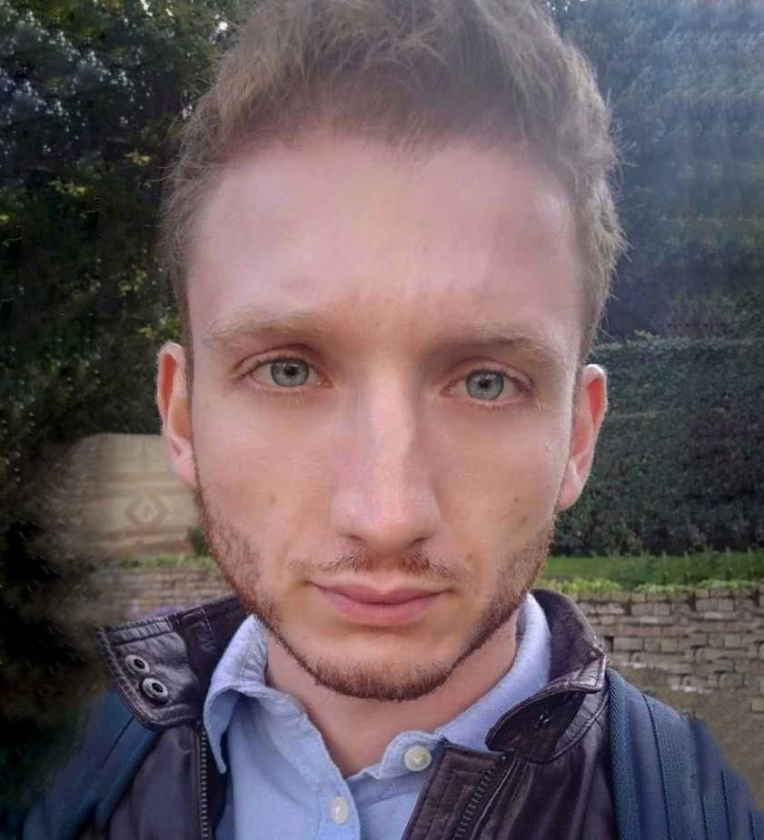

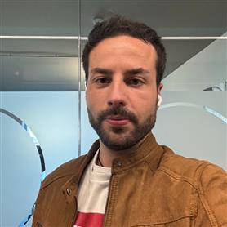

Thank you
Code and slides
Salvatore Matrisciano
Mobile Developer
salvatorematrisciano.com
Stefano Soriano
Mobile Developer
linkedin.com/in/stefanosoriano51
github.com/MatriscianoSalvatore/ai-pantry
Notes:
And that’s all. Thank you so much!
The AI Pantry code is open source: you’ll find it on GitHub, at the link you see here, github.com/MatriscianoSalvatore/ai-pantry.
Download it, try it on your phone, open an issue if it breaks. You’ll also find the slides of the talk in the repo.
And if you want to keep the conversation going, you’ll find our contacts here: Salvatore’s website and my LinkedIn.
Or just stop us later, we’re here all day.
Thanks again to DevFest Milano and to all of you.
If you have any questions, we’re here!

Slide 27
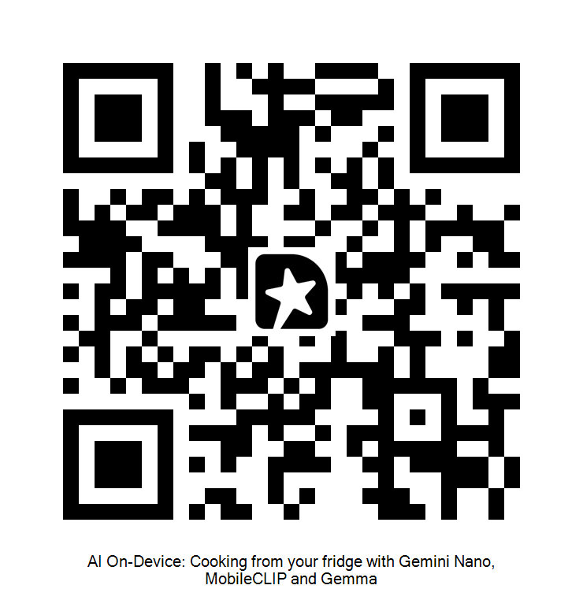
  FEEDBACK
How did it go?
Scan the QR code to leave feedback on the talk
Notes:
Before we say goodbye, one last thing.
You can scan this QR code to leave us feedback on the talk.
It helps us improve, and it helps the event organizers understand what people liked.
And now, if you have any questions, we’re here!

